Slide 1
An Automated Prototype Integrating RFID Authentication and IR Sensor Alignment
P.K. CHITRA IYER(2301EE08)(PROJECT LEAD)
GAURAV BHAGURE(2301EE11)
TEJAS RAJU PANZADE(2301EE34)
K. SAI GANESH SARMA(2301EE32)
VANSH KUMAR(2301EE48)

Slide 2
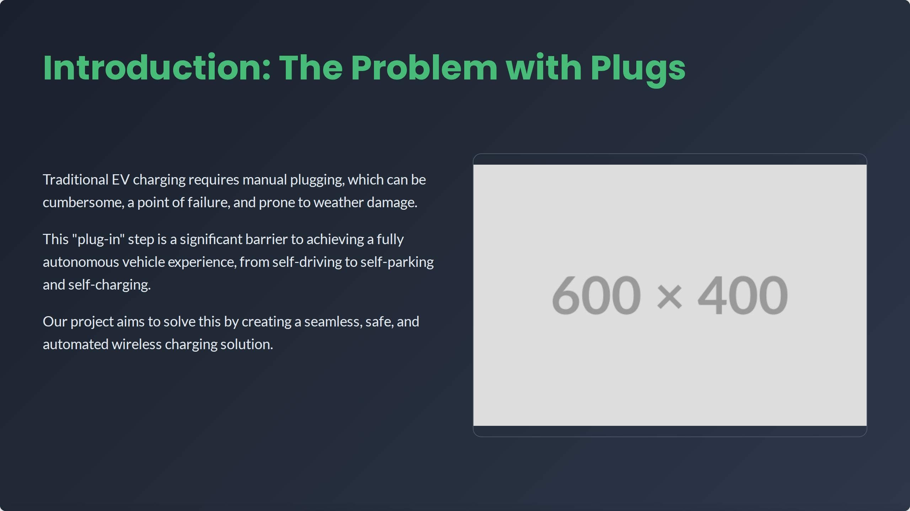
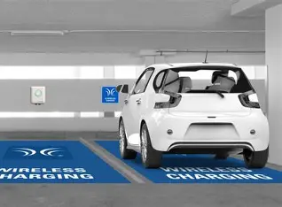

Slide 3

Demonstrate functional Inductive Power Transfer (IPT) between a transmitter and a receiver coil.
Design an automated alignment system using IR sensors and a servo motor to maximize power transfer efficiency.
Implement an RFID system for secure, contactless user authentication before enabling a charging session.
Integrate all subsystems using two Arduino Nano boards for control logic and communication.

Slide 4
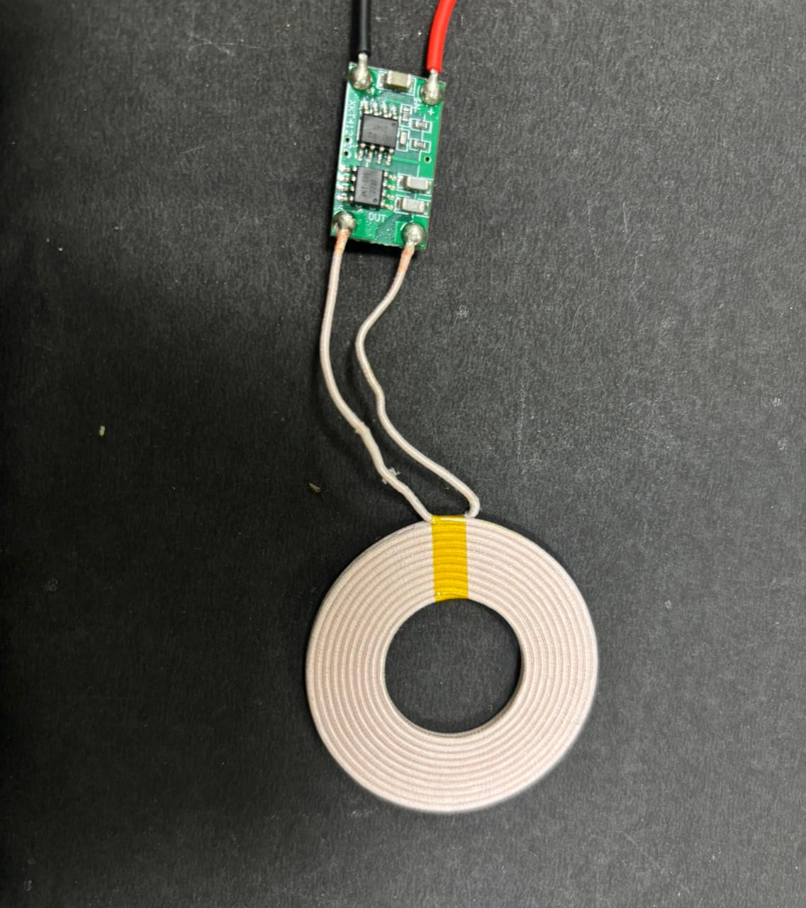
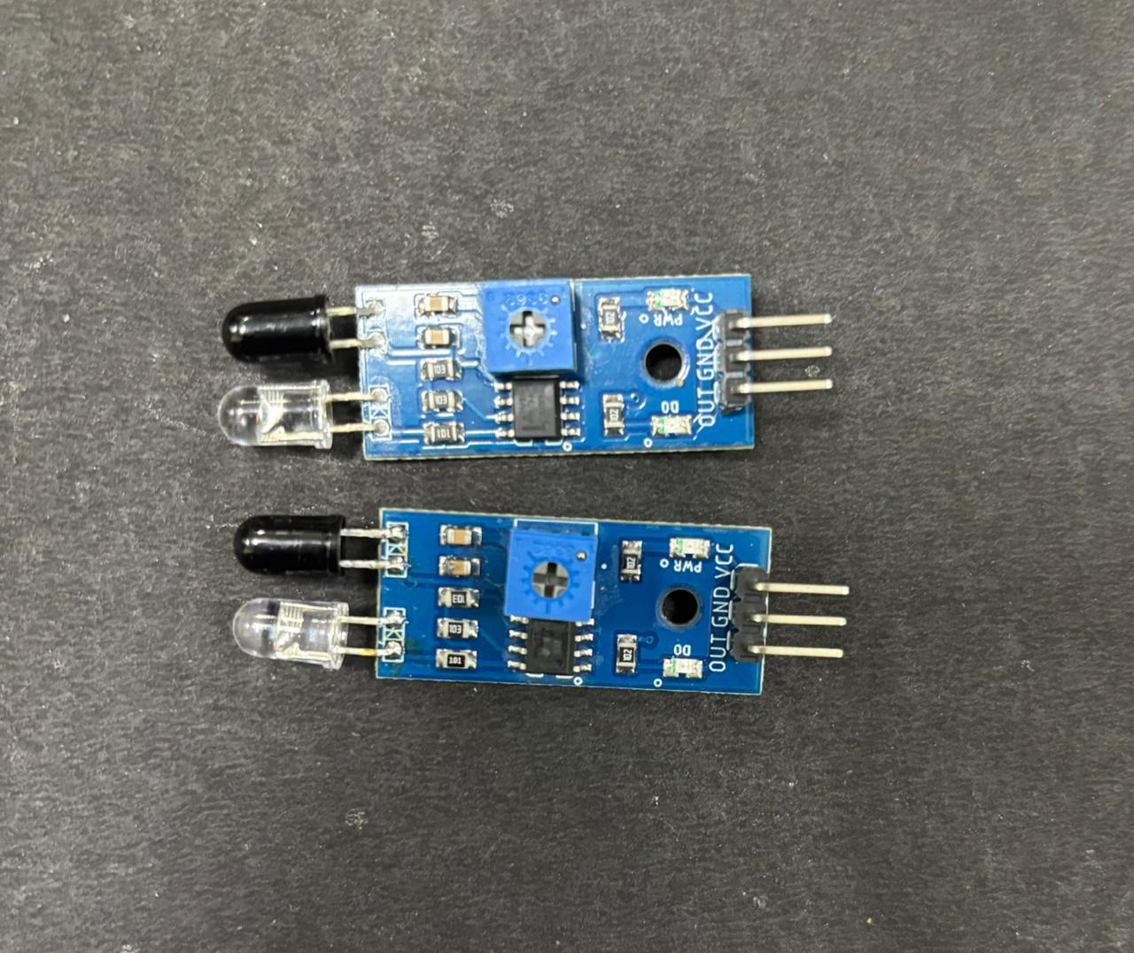
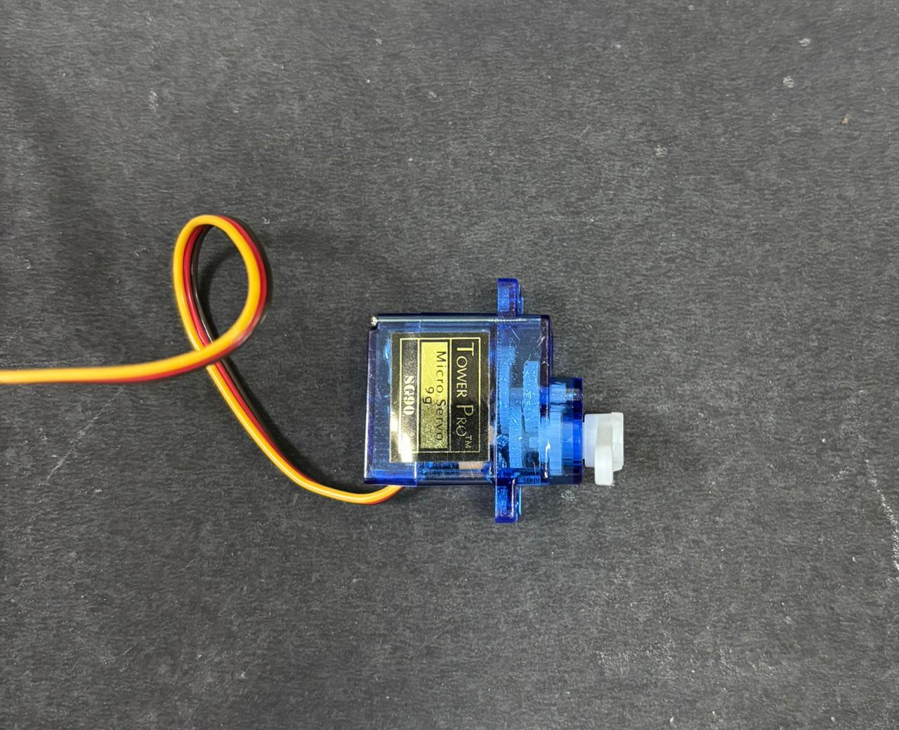
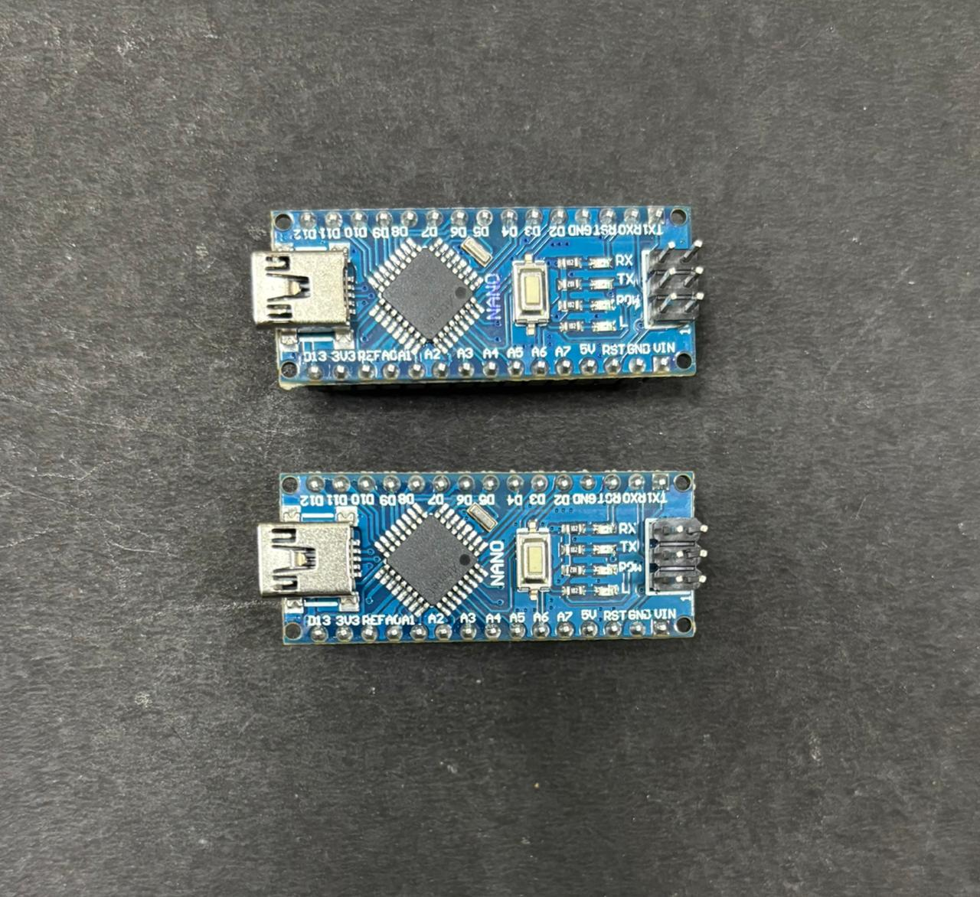
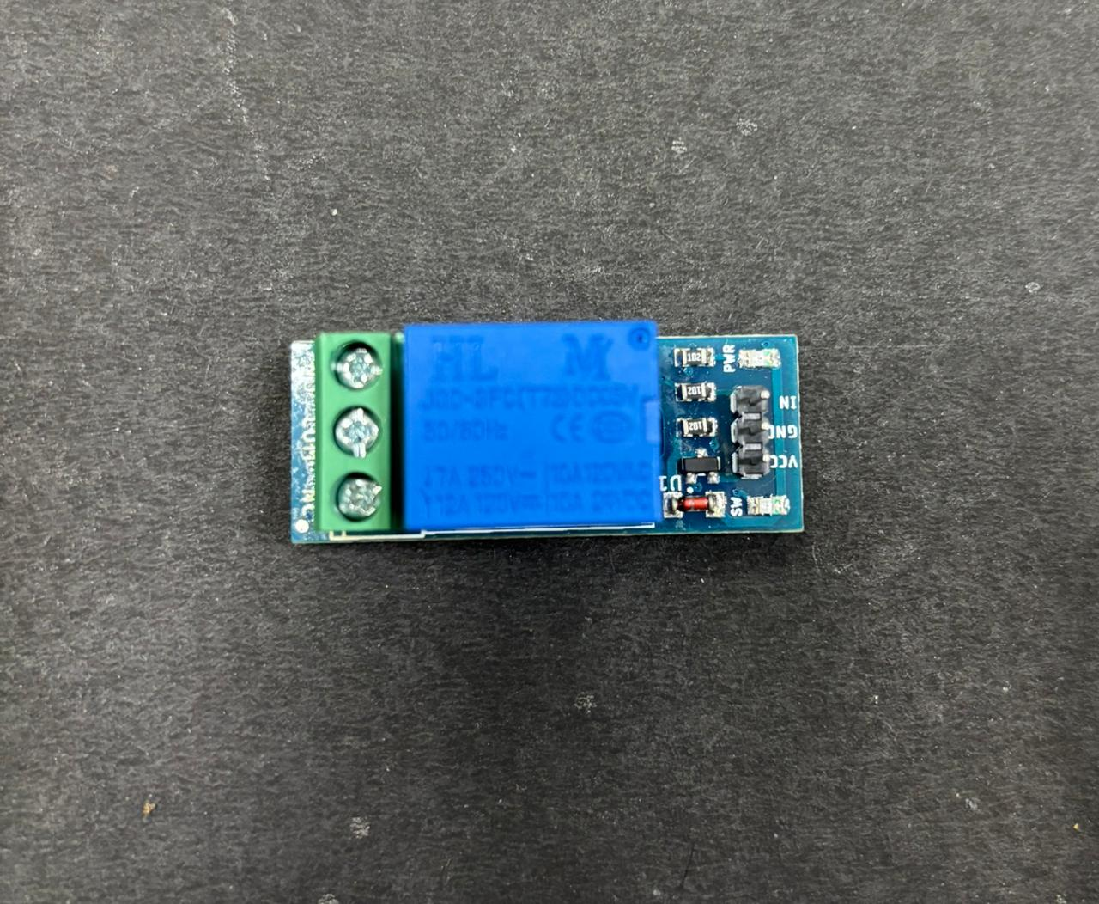
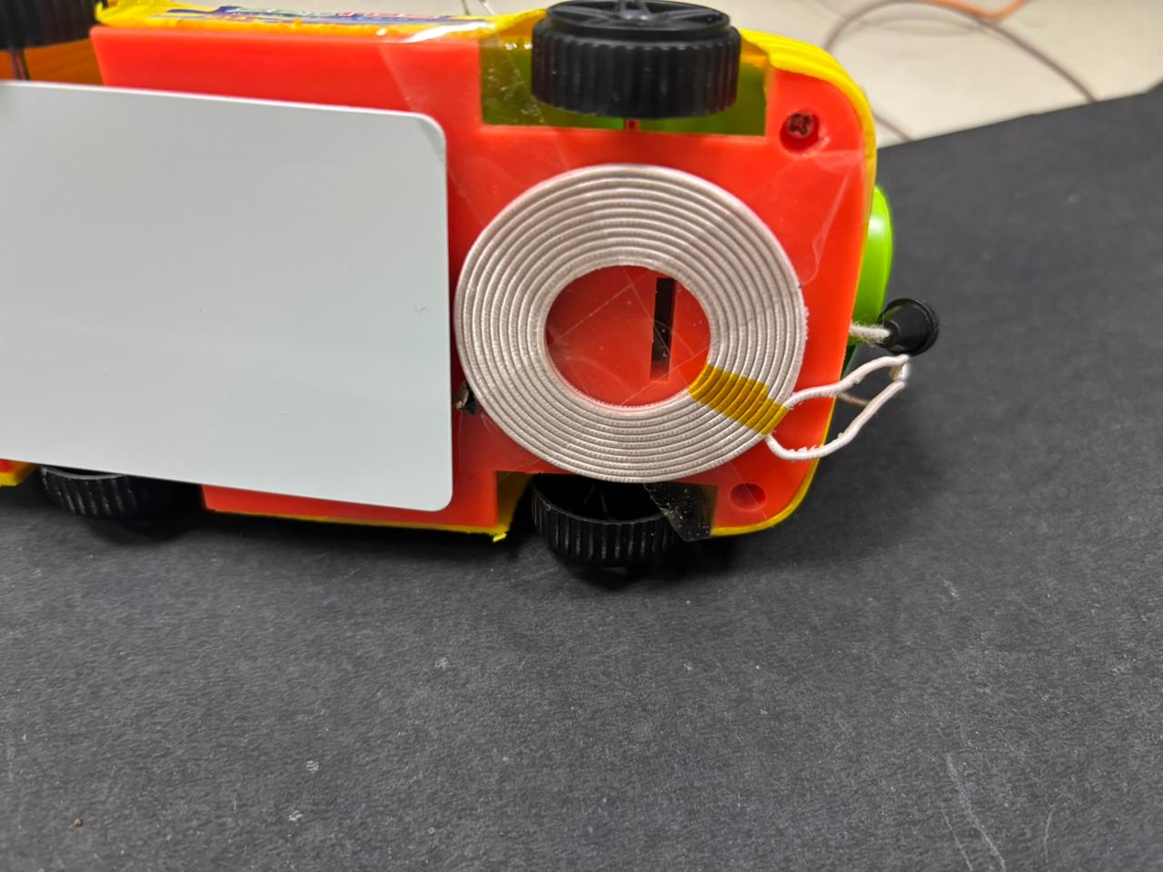
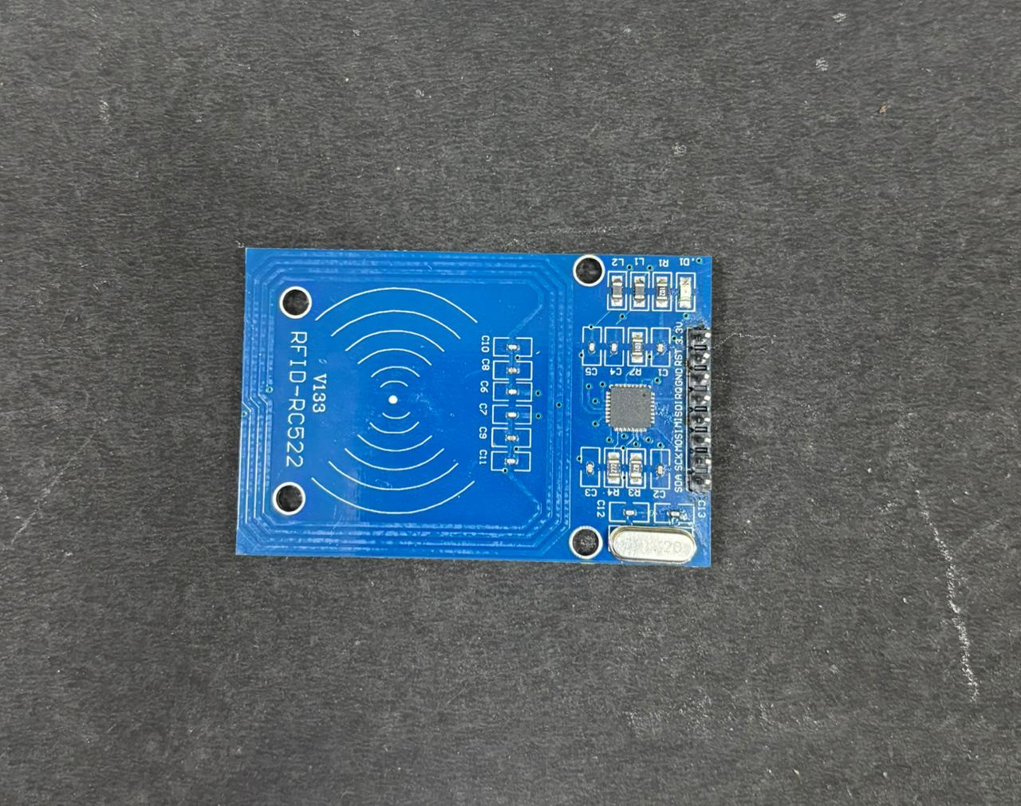
COMPONENTS USED:
2 X IR SENSORS SERVO MOTOR 2 X ARDUINO NANO TRANSMITTING
COIL (XKT-412)
RELAY MODULE RECEIVING COIL (XKT-412) RFID READER

Slide 5
Complete System Architecture:
Arduino Nano (Controller): This is the brain of the station. It manages everything.
IR Sensors (Parking Detectors): These act like eyes, telling the Arduino if an EV is correctly parked over the charging spot. If the EV isn't in the right place, the system won't activate.
Servo Motor (Alignment Assistant - Optional):Its main function is to allow the vehicles through the gate through the IR sensor detection(open and close of gate).
Arduino Nano (In-Car Controller): This small computer inside the car manages how the power is received and delivered to the car's battery.
RFID Reader (Car Identifier - Optional but useful): This can identify the specific EV or user. For example, it could check if the car is authorized to charge or track charging sessions.
Relay Module (Power Switch): When an EV is correctly parked, the Arduino tells the Relay Module to turn on the power to the charging system. It's like a big on/off switch for the wireless charging.
Transmitting Coil (Power Broadcaster): Once the Relay Module turns on, this coil sends out the electrical energy wirelessly. Think of it like a Wi-Fi router, but for power instead of internet.
Receiving Coil (Power Catcher): This coil is in the EV. When it's over the Transmitting Coil at the station, it catches the wireless energy being sent.

Slide 6
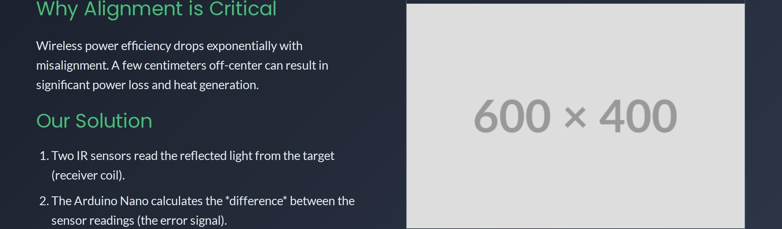
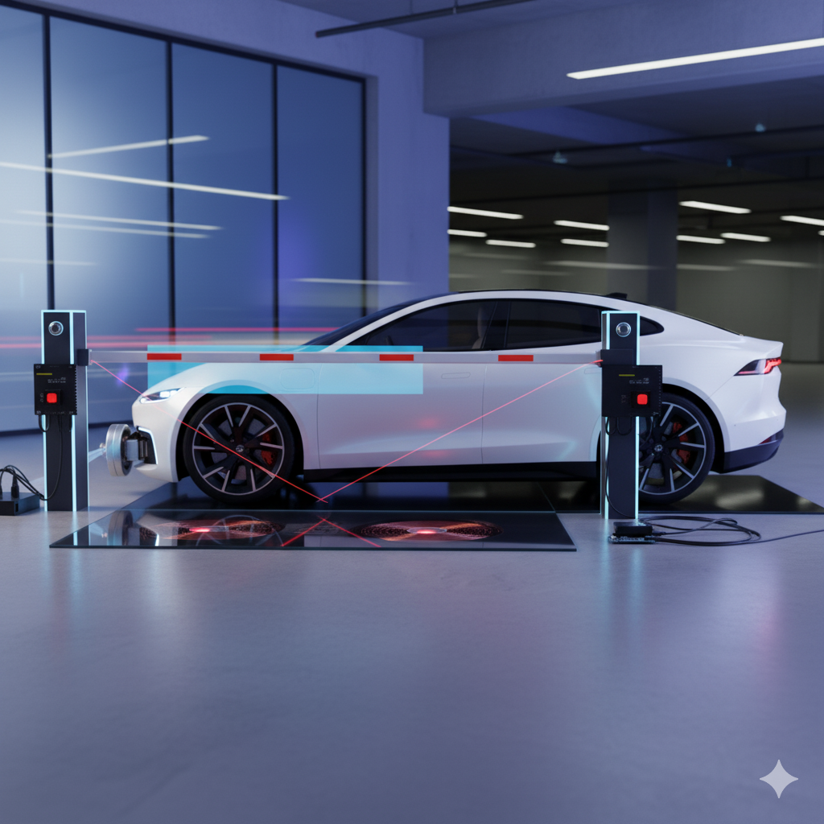
3. A servo motor adjusts the coil's position until this error is
zero, indicating perfect centering.

Slide 7
CODE 1:
// Nano 1: Automatic Gate Control (Servo and IR Sensors)
#include <Servo.h>
// --- I/O Pin Definitions (Matching Wiring Table) ---
const int entrySensorPin = 2; // Connected to the OUT pin of the Entry IR Sensor
const int exitSensorPin = 3; // Connected to the OUT pin of the Exit IR Sensor
const int servoPin = 9; // Connected to the Signal pin of the Servo motor (must be PWM)
Servo gateServo; // Create a servo object
const int gateOpenAngle = 90; // Angle for the open gate
const int gateClosedAngle = 0; // Angle for the closed gate
void setup() {
Serial.begin(9600);
// Initialize IR sensor pins as input
pinMode(entrySensorPin, INPUT);
pinMode(exitSensorPin, INPUT);
// Attach the servo object to the defined pin
gateServo.attach(servoPin);
// Ensure the gate starts closed
gateServo.write(gateClosedAngle);
Serial.println("Gate Control Initialized. Gate Closed.");
}
void loop() {
// Read sensor states (LOW means object detected)
int entrySensorState = digitalRead(entrySensorPin);
int exitSensorState = digitalRead(exitSensorPin);
// --- Gate Logic ---
// Open gate if either sensor detects a car
if (entrySensorState == LOW || exitSensorState == LOW) {
if (gateServo.read() <= (gateClosedAngle + 5)) {
openGate();
}
}
// Close gate only if both sensors are clear
else if (entrySensorState == HIGH && exitSensorState == HIGH) {
if (gateServo.read() >= (gateOpenAngle - 5)) {
closeGate();
} }
delay(100); // Small delay for stable readings
}
// Function to smoothly open the gate
void openGate() {
Serial.println("Object Detected. Opening Gate...");
for (int pos = gateServo.read(); pos <= gateOpenAngle; pos += 1) {
gateServo.write(pos);
delay(15); // Adjust delay for desired speed
}
}
// Function to smoothly close the gate
void closeGate() {
Serial.println("No Object Detected. Closing Gate...");
for (int pos = gateServo.read(); pos >= gateClosedAngle; pos -= 1) {
gateServo.write(pos);
delay(15); // Adjust delay for desired speed
}
}Code 1 for Gate

Slide 8
// Nano 2: Smart Charging Logic (RFID and Relay)
#include <SPI.h>
#include <MFRC522.h> // Library for the RFID Reader (install this one!)
// --- I/O Pin Definitions (Matching Wiring Table) ---
#define SS_PIN 10 // SDA (Slave Select) pin for the MFRC522 (D10)
#define RST_PIN 9 // Reset pin for the MFRC522 (D9)
const int relayPin = 4; // Digital pin connected to the IN pin of the Relay Module
// --- CRITICAL: AUTHORIZED TAG UID ---
// You MUST replace this with the actual UID of your RFID card/tag.
// Get your tag's UID by running a simple "DumpInfo" example from the MFRC522 library first.
// Example format: {0x11, 0x22, 0x33, 0x44}
byte authorizedTag[] = {0xA1, 0xB2, 0xC3, 0xD4}; // <-- REPLACE THIS UID
MFRC522 mfrc522(SS_PIN, RST_PIN); // Create MFRC522 instance
void setup() {
Serial.begin(9600);
SPI.begin(); // Initialize SPI bus
mfrc522.PCD_Init(); // Initialize MFRC522
// Initialize Relay pin as output.
pinMode(relayPin, OUTPUT);
// Ensure charging is OFF initially (HIGH is typically OFF for common Active-LOW relays)
digitalWrite(relayPin, HIGH);
Serial.println("Smart Charging System Initialized.");
Serial.println("Ready for EV Scan...");
}
void loop() {
// Check if a new tag is present
if (mfrc522.PICC_IsNewCardPresent()) {
// Select the tag
if (mfrc522.PICC_ReadCardSerial()) {
// Print the UID (Car ID) for data logging
Serial.print("Scanned Card UID: ");
String currentUID = getCardUID();
Serial.println(currentUID);
// Check if the scanned card is authorized
if (checkIfAuthorized(mfrc522.uid.uidByte, authorizedTag)) {
Serial.println("ACCESS GRANTED: Authorized EV. Starting charge...");
startCharging();
} else {
Serial.println("ACCESS DENIED: Unknown EV. Charging blocked.");
stopCharging();
}
// Halt the card reading process to prevent continuous re-reading
mfrc522.PICC_HaltA();
} }}
// Function to convert the byte array UID to a human-readable string
String getCardUID() {
String content= "";
for (byte i = 0; i < mfrc522.uid.size; i++) {
content.concat(String(mfrc522.uid.uidByte[i] < 0x10 ? " 0" : " "));
content.concat(String(mfrc522.uid.uidByte[i], HEX));
}
content.toUpperCase();
return content.substring(1); // Remove leading space
}
// Function to compare the scanned UID with the authorized UID
bool checkIfAuthorized(byte *scannedUID, byte *authorizedUID) {
for (byte i = 0; i < mfrc522.uid.size; i++) {
if (scannedUID[i] != authorizedUID[i]) {
return false;
}
}
return true;
}
// Function to activate the charging system
void startCharging() {
// Relay is activated (LOW for Active-LOW relay)
digitalWrite(relayPin, LOW);
Serial.println("--- CHARGING ACTIVE ---");
}
// Function to deactivate the charging system
void stopCharging() {
// Relay is deactivated (HIGH for Active-LOW relay)
digitalWrite(relayPin, HIGH);
Serial.println("--- CHARGING INACTIVE ---");
}Code 2 for RFID

Slide 9
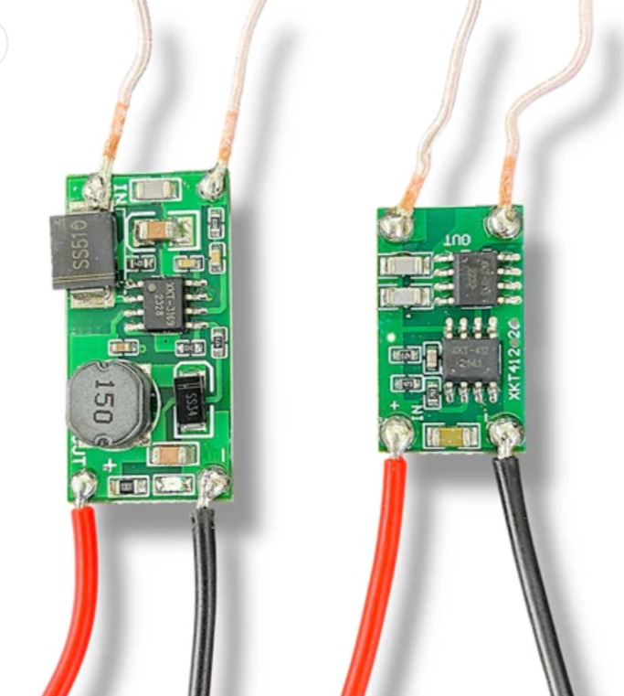
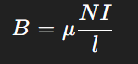
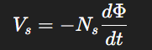
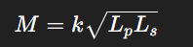
WORKING PRINCIPLE:
Electromagnetic Theory (EMT) Behind Wireless Charging Wireless charging works on Faraday’s Law of Electromagnetic Induction → a changing magnetic field creates voltage in the secondary coil.
1️⃣ Magnetic Field Generation (Transmitter Coil)
When current flows through the primary coil:
This magnetic field expands and links with the receiver coil.
2️⃣ Induced Voltage (Receiver Coil)
Due to changing flux:
This creates AC voltage in the EV’s receiving coil.
3️⃣ Mutual Inductance (M)
Wireless transfer works because the coils share magnetic flux:
Higher alignment → higher coupling → higher power transfer.

Slide 10
WORKING PRINCIPLE:
Transmitter (Tx) Side: Generating the Magnetic Field
The transmitter section begins by converting the DC supply into a high-frequency AC signal. This is necessary because a constant DC current cannot create a changing magnetic field, and only a changing magnetic field can induce power in the receiving coil. The alternating current flows through the transmitter coil, generating a continuously varying magnetic field around it. The efficiency of power transfer depends on the coupling coefficient k, which indicates how well the magnetic field from the transmitter links with the receiver coil. A value of k ≈ 1 represents maximum coupling and high efficiency.
Receiver (Rx) Side: Harvesting and Converting the Energy
When the magnetic field produced by the transmitter reaches the receiver coil, it induces an AC voltage across the coil terminals through electromagnetic induction. This induced AC voltage is then processed by the receiver circuitry, where it is rectified into DC and regulated to a stable 5 V output suitable for charging or powering the load. Proper alignment and minimal distance between the coils help maintain a high coupling coefficient k, ensuring efficient energy transfer.

Slide 11
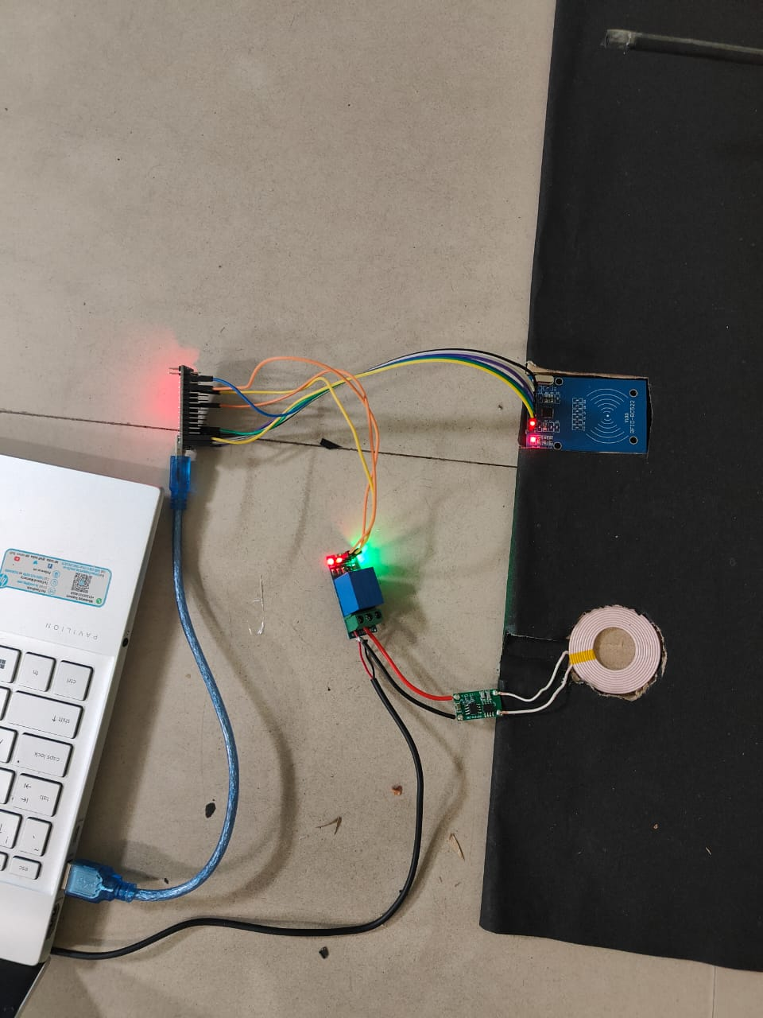
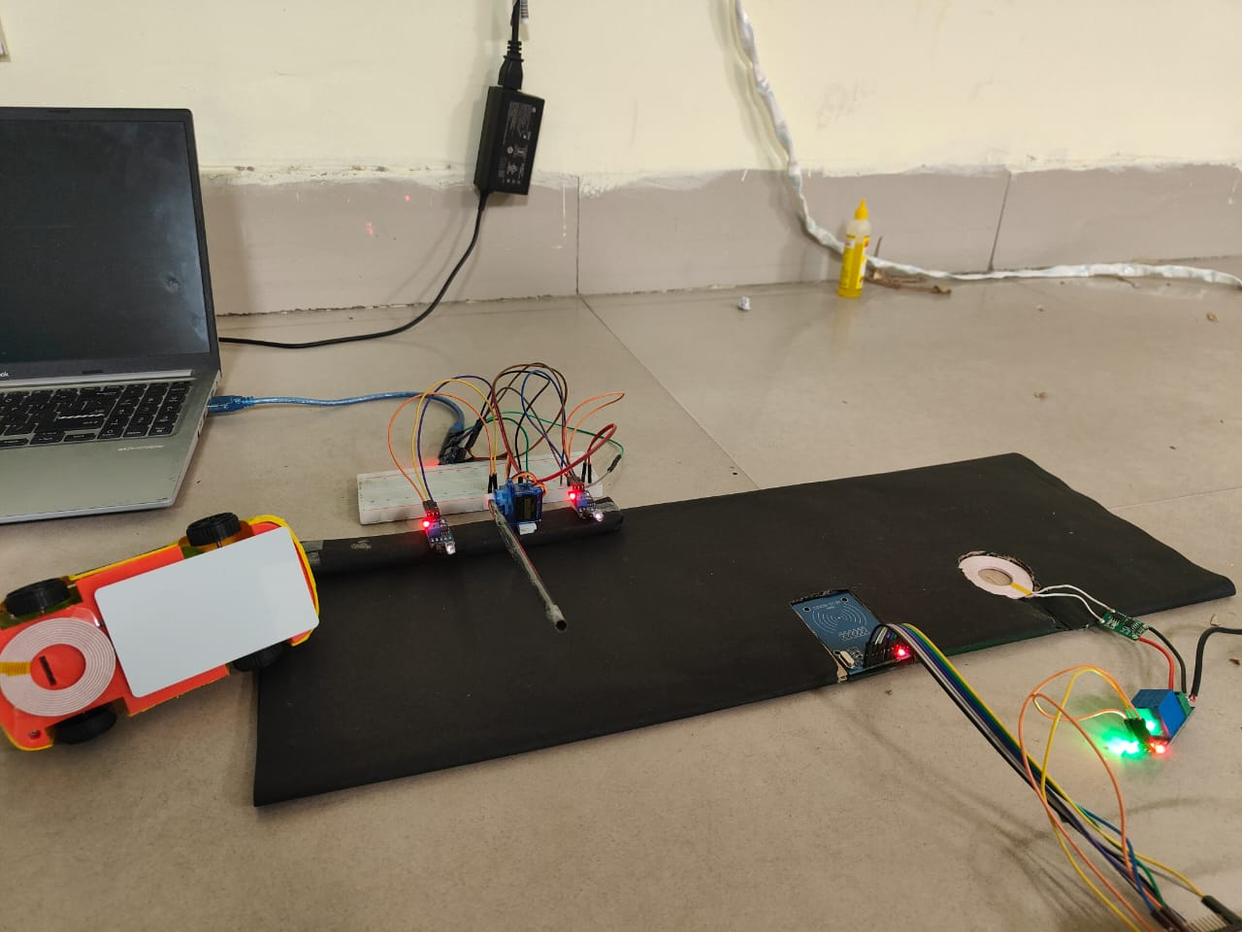

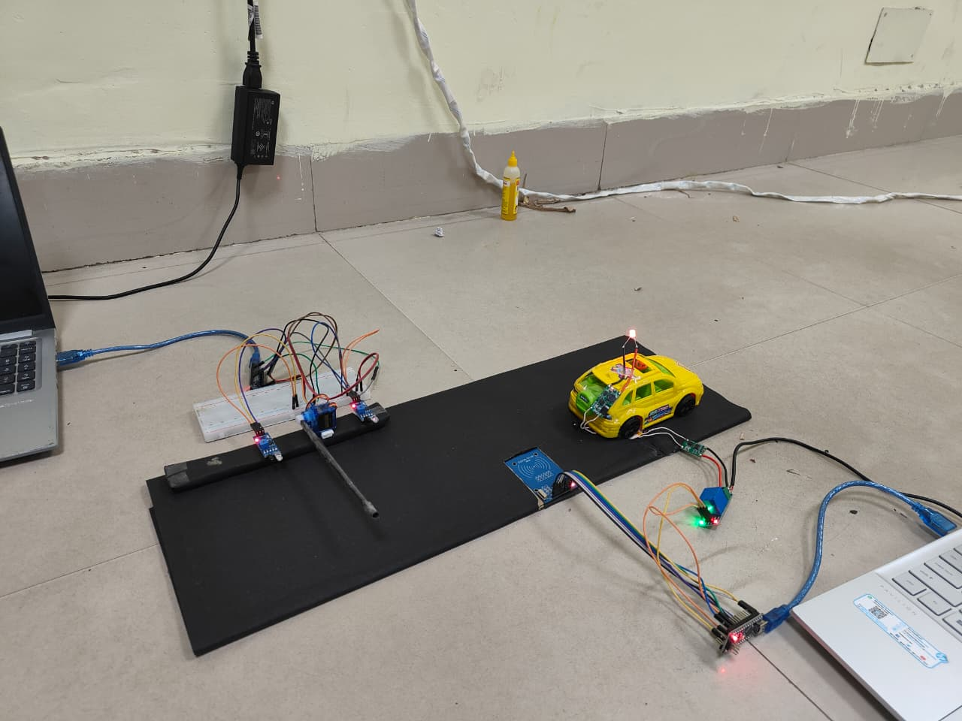
Transmitter (Ground) Assembly
Receiver (Vehicle) Assembly
Integrated System Prototype

Slide 12
Observations:
Gate opens smoothly as the car approaches.
Gate closes smoothly after the car passes through.
RFID reader successfully reads the authorized tag.
Serial monitor confirms "ACCESS GRANTED" and "CHARGING ACTIVE."
The relay clicks (or indicates activation), signifying power is being supplied for charging.
The LED glows as the indication of the car being charged.
KEY RESULTS:
Secure Access: Only authorized EVs can initiate charging.
Automated Entry/Exit: The gate responds automatically to vehicle presence.
Functional Charging Control: The relay accurately switches the simulated charging power based on authentication.

Slide 13






Process Flow: The User Journey
Conclusion:
Feasibility & Modularity: Project validates wireless power transfer principles and demonstrates a modular system for EV charging.
Basic Automation: Achieved fundamental automation for parking detection and power control using IR sensors and a relay.
Foundation: Provides a strong prototype for future, more advanced wireless charging development.

Slide 14
1. RFID Code Feasibility
Challenge: Integrating RFID reads into the charging system's logic.
Solution: Use modular code and libraries for reads. Implement a clear state machine with error handling.
2. Component Issues
Challenge: Reliability and compatibility of hobby-grade electronic parts.
Solution: Source wisely and test each part individually. Verify compatibility via datasheets, manage power budget.
3. Wireless Power Transfer Efficiency
Challenge: Low power transfer and limited range from basic coils.
Solution: Optimize coil design and tune for resonance using capacitors. Utilize ferrite cores and precise alignment.
4. System Integration & Debugging
Challenge: Making all diverse hardware and software elements work together.
Solution: Employ modular code, serial debugging, and LED indicators. Integrate components step-by-step.
5. Power Management
Challenge: Providing stable, adequate power to all high-current and sensitive circuits.
Solution: Use separate power supplies and voltage regulators. Add decoupling capacitors and appropriate wiring.

Slide 15
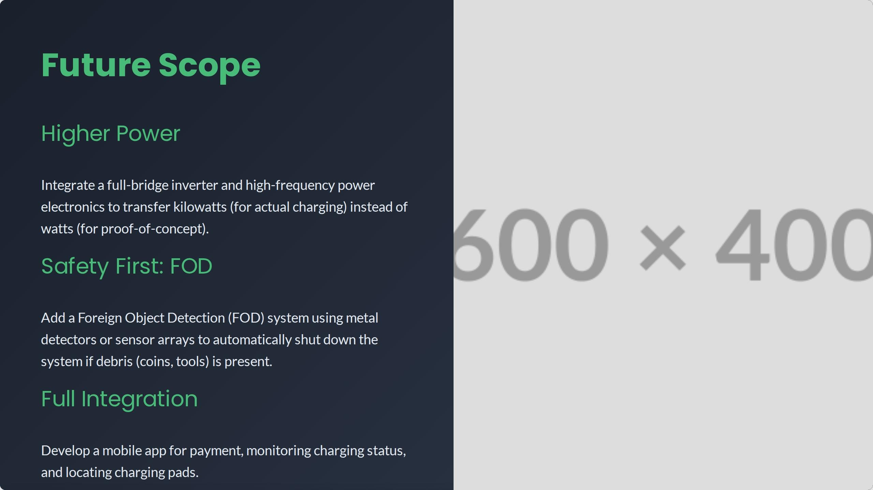


Slide 16
REASONS THAT OBSTRUCT THIS PROJECT IN THE PRESENT:
Low Power/Efficiency & EMI: Current prototype struggles with high power demands and potential electromagnetic interference.
Safety Concerns: Major hurdles include human EMF exposure and the need for robust Foreign Object Detection (FOD) to prevent hazards.
Alignment & Cost: Precise coil alignment is critical but challenging, and scaling to commercial levels is currently expensive and complex.
Lack of Standards & Regulations: No universal standards exist, and rigorous regulatory approvals for high-power wireless systems are pending.
Thermal & Durability: Managing heat at higher power and ensuring coils withstand environmental stress are significant challenges.

Slide 17
GAURAV BHAGURE(2301EE11): Alignment System Lead (IR Sensors & Servo)
Develops alignment Arduino code, IR sensor processing, servo control, and designs mechanical mounts.
P.K. CHITRA IYER(2301EE08): Inductive Power Transfer (IPT) Coils & Project Manager Designs/sources IPT coils, sets up power, and designs mechanical housings for coils.
TEJAS RAJU PANZADE(2301EE34): System Integration & Testing Engineer
Develops and executes full system test plans, documents results, challenges, and debugging.
K. SAI GANESH SARMA(2301EE32): Documentation Lead & Future development
Compiles report (abstract, conclusion,) Future scope, and delivers presentation.
VANSH KUMAR(2301EE48): Main Control & RFID System Lead
Develops main Arduino code, RFID authentication, and inter-Arduino communication.
THANK YOU!!!

